Slide 1

Design & Development of Wrist Mounted Smart Device
Final Year Project – CHP2524-2324
Oliver Lewis: U1961638
30/01/2024

Slide 2

Introduction

Slide 3


1st February
Initial Proposal
15th February
Finalise
Proposal
22nd February
Literature Review
Project Timeline
30th April
Present Product
30th February
Literary Evaluation
Complete
28/02/2024
Monday 29th April
Final Report
Complete
09/03/2024
Monday 20th April
Evaluation
20th March
Poster Session
11th March
Poster Submission
6th March
GUI Design

Slide 4
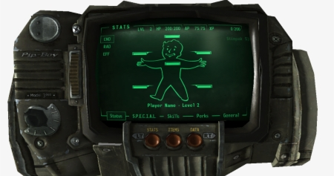
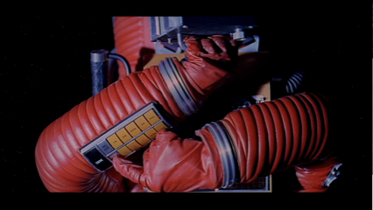
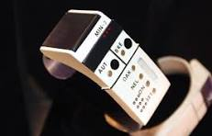
Inspirations for the idea
Often depicted within the realms of science fiction and fantasy, technologically advanced wrist mounted computers which are multi-functional tools, capable of enhancing the users lives with improvements to health, communication, information access, and connectivity, have long been the dreams of technology and sci-fi enthusiasts alike.
Some of the inspiration behind the idea comes from a variety of such media, including video games, films and television like Star Trek, Fallout, and 2001 a space Odyssey to name a few examples.
Bethesda Game Studios (2008), Fallout 3 [Video Game]
The device featured in this game known as the Pip-Boy, which acts as the players/In game characters personal hub displaying their general health and any conditions or afflictions they may have acquired such as infections and addictions. The device also acts as a catalogue of items the player has on their person, displaying amounts and specifics about each item as well as allowing the player to view and map the areas they have explored and connect to the in-game radio stations.
(Fallout Pip Boy, PNGitem, n.d.)
Kubrick, S. (Director). (1968) 2001: A Space Odyssey [Film]. Stanley Kubrick Productions (1:17:14)
An early rendition envisioning the future of space travel and the devices associated with being able to achieve such feats, from a film that has influenced and inspired popular culture for generations from the ideas it has generated, and the aesthetical choices made for the design and intent of the technology depicted in the film.
Roddenberry, G. (Executive Producer),Star Trek (September 8,1966 – June 3, 1969), NBC
Another classic example of wearable sci-fi technology, known as the wrist communicator from the original star trek television series. Simply used to allow the crew members to effectively communicate with one another across large distances, including the additional functions of location tracking and being able to connect directly to their spacecraft.
(Wheeler, n.d.)

Slide 5
Mood board
Amalgamation of images relating to the project and the proposed device, including device designs, GUI layouts, inspirations, colour schemes, comparable existing products, potential features, and other similar images to help generate ideas.

Slide 6
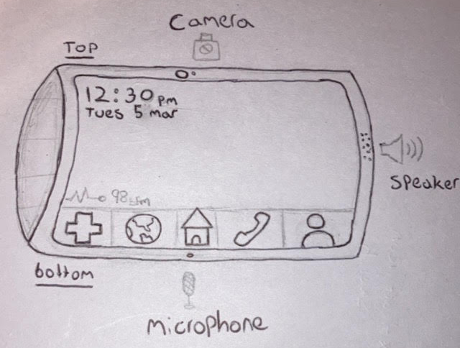
Early-Stage Sketches
The primary sketch pictured on the top right is sketch.1, portraying how the device is intended to look, featuring a 3.5-inch curved touch screen which is ergonomically shaped to comfortably fit around the user's wrist without being over encumbering and for ease of use.
Pictured on the bottom right is sketch.2, depicting the further developed concept of the proposed device, you can see some of the initial features and pieces of hardware being decided upon. Such as the placement of a camera, microphone, and speaker which are commonplace on most smart devices.

Slide 7
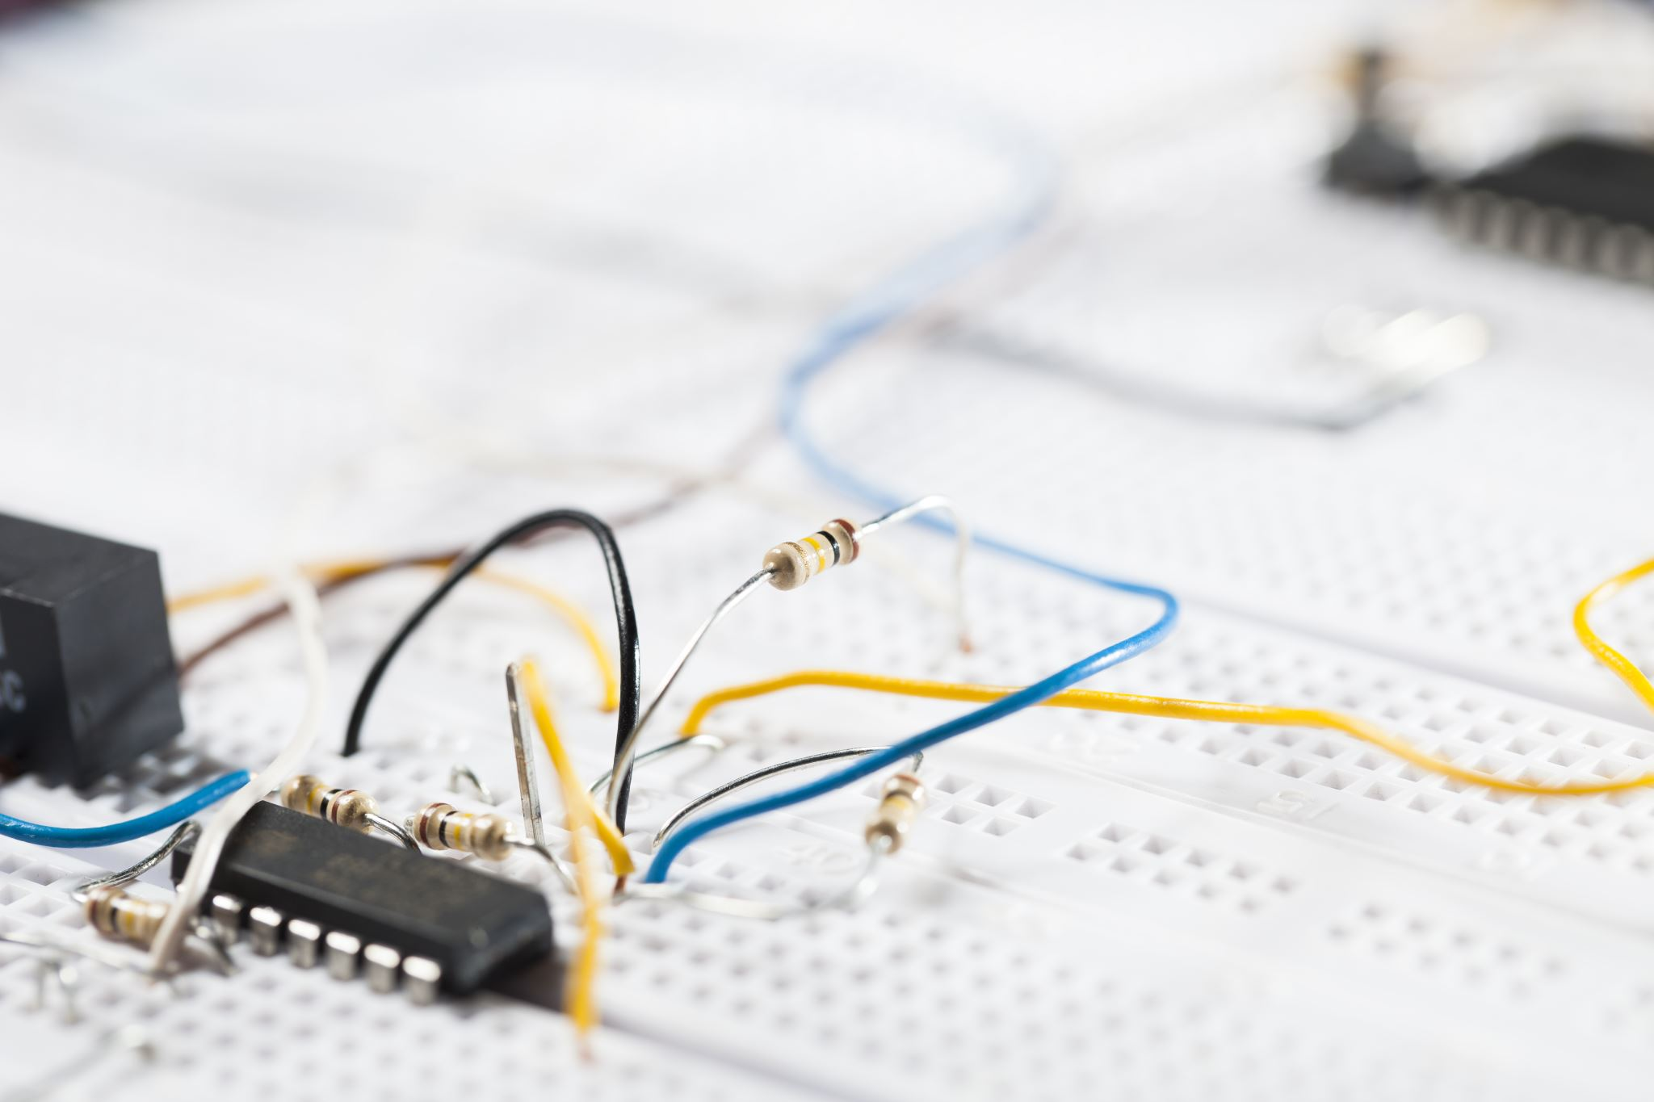
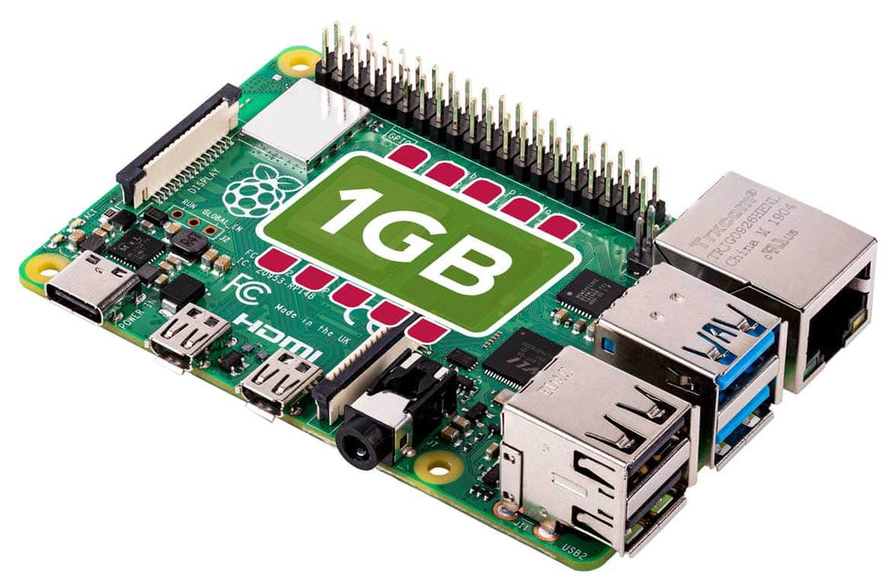
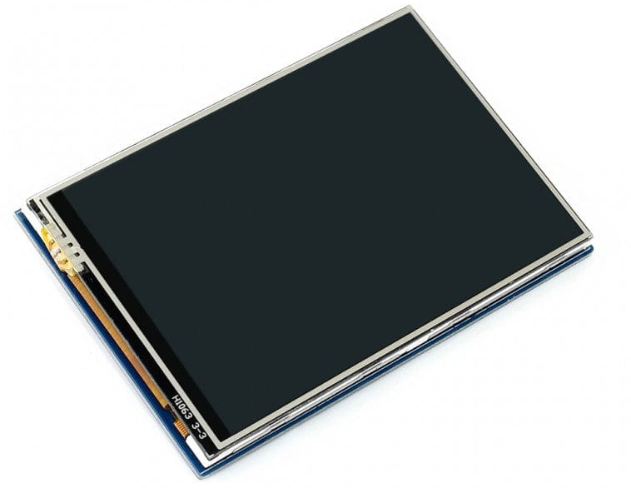
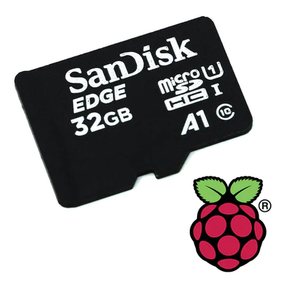
Potential Prototype Hardware
Raspberry Pi Board 4B:
1.5GHz 64-bit quad-core CPU
1GB RAM
OpenGL ES 3.0 graphics
3.5" IPS Touch Screen:
480×320 resolution
Resistive touch control
Micro SD Card:
32GB storage
Operating System
https://thepihut.com/
Source:

Slide 8
References & Citations
Bethesda Game Studios (2008), Fallout 3 [Video Game] : Fallout | Bethesda.net. (n.d.). https://fallout.bethesda.net/en/games/fallout-3 Fallout Pip Boy PNG , PNG download - Raspberry Pi Zero Pip Boy, Transparent PNG , Transparent PNG Image - PNGitem. (n.d.). PNGitem.com. https://www.pngitem.com/middle/iRhmmTh_fallout-pip-boy-png-png-download-raspberry-pi/
Roddenberry, G. (Executive Producer),Star Trek (September 8,1966 – June 3, 1969), NBC Wheeler, C. (n.d.). Wrist Communicator. Flickr. https://www.flickr.com/photos/28221085@N03/4328189080

